Slide 1
Fourier space stitching
Anders Pedersen
23-07-2018

Slide 2
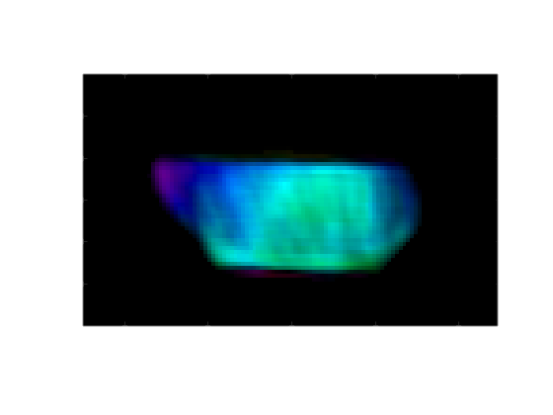
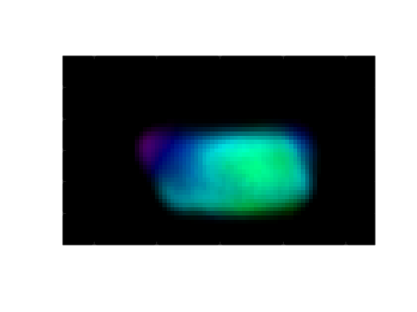
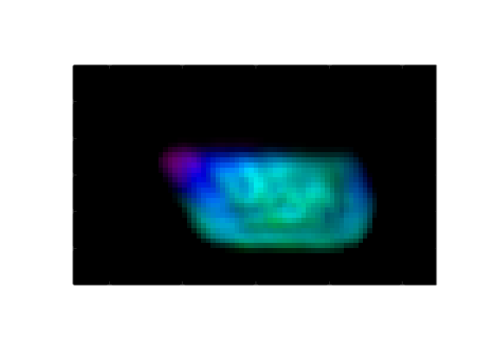
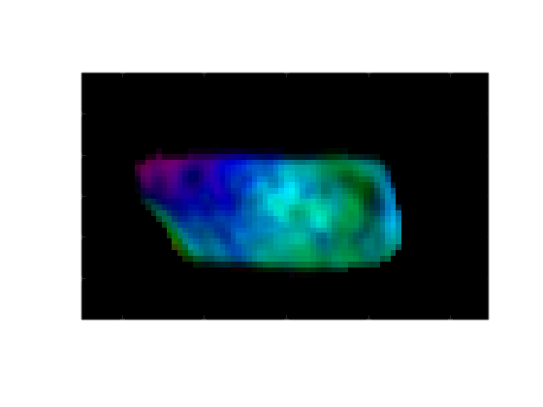
Reconstruction slices
No lens (benchmark)
Lens, virtual image geometry, single lens position
Lens, virtual image geometry, 9 lens positions, stitching method 1
Lens, virtual image geometry, 9 lens positions, stitching method 2

Slide 3
Reconstruction methods
Method 1
Method 2
Reconstruct the fields (Fourier space) individually
After reconstruction shift and average the individual fields to achieve a higher resolution
More stable, no super resolution issues as the pupil is not used
Increase in spatial resolution, but not as much as method 2
Reconstruct a combined field (Fourier space) by only updating the amplitude within the pupil, and weighted by the width of the pupil
Not as stable, need to reduce amplitude outside the pupils
Higher spatial frequencies, perhaps higher resolution
Stronger intensity variations in the reconstructed object

Slide 4
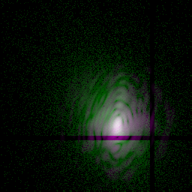
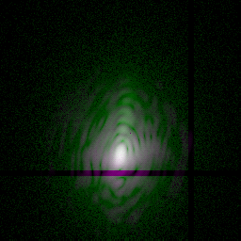
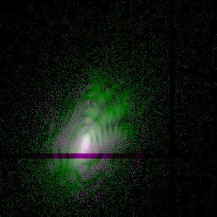
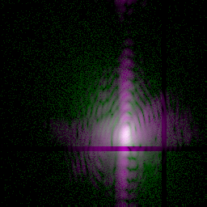
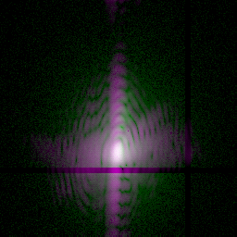
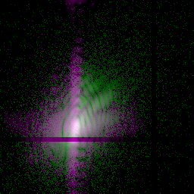
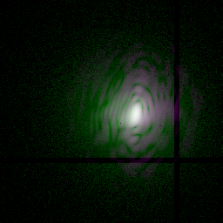
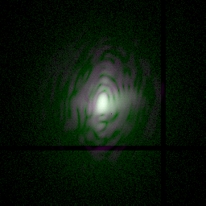
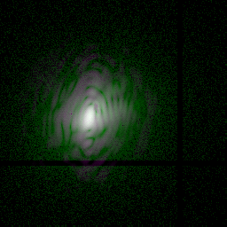
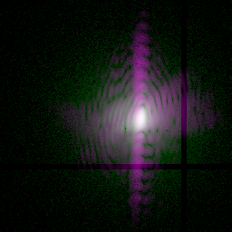
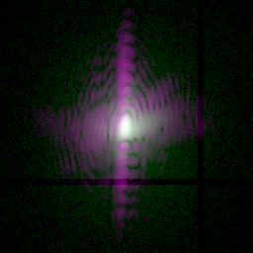
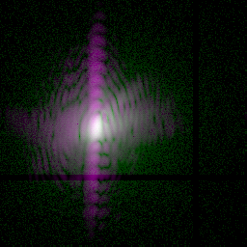
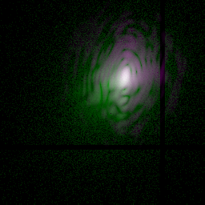
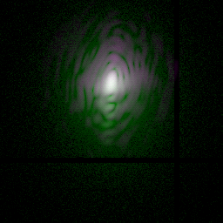
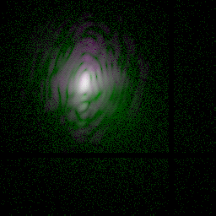
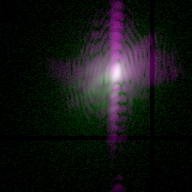
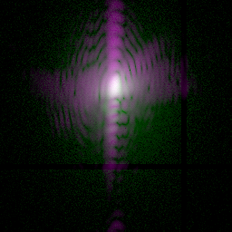
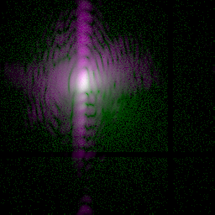
Fourier space
Method 1
Method 2
Green = measured data, magenta = reconstruction, i.e. gray = perfect match of data/reconstruction. In method 2 the support is forced a bit tighter, giving rise to the strong vertical set of fringes.

Slide 5
Which is better?
Not sure?
I believe method 2 has potential for better resolution in general, and super resolution is possible, if proper constraints are used (I don’t know the best way of doing that)
In this case the data quality is not perfect: we know that the sample drifted, and I can see tiny differences in the overlapping fringe pattern from different lens positions, which should be identical. So in our case maybe we should go with method 1, since it is a bit more stable and more conservative. Visually the reconstruction with method 1 also looks more pleasing to the eye in my opinion.

